Slide 1
Lecture 3 (Advanced Generative AI)
Unisole empower

Slide 2
Objectives of Lecture 3
Understand why training large foundation models runs into GPU memory limits
Apply quantization to reduce required GPU RAM using lower-precision data types
Optimize the self-attention layers with FlashAttention and grouped-query attention
Scale training across many GPUs with DDP and FSDP distributed strategies
Run distributed training on AWS with Amazon SageMaker, the Neuron SDK and AWS Trainium

Slide 3
The Memory Challenge
Why large foundation models run out of GPU memory

Slide 4
Why Models Run Out of Memory
A single FP32 parameter = 4 bytes. Loading a 1B-parameter model needs 4 GB — but training it needs ~6× more.
GPU RAM for a 1B-param model (FP32)
Memory state (per parameter) | Bytes
Model parameters (weights) | 4
Adam optimizer (2 states) | 8
Gradients | 4
Activations + temp memory | 8
TOTAL to train | 24
24 GB
≈ 6× more
4 GB
Load
Load + Train

Slide 5
AWS Trainium — Purpose-Built ML Accelerators
NVIDIA A100 / H100 GPUs support only up to 80 GB of GPU RAM — a hard ceiling for very large models
AWS Trainium is a purpose-built accelerator for cost-efficient training of 100B+ parameter models
Accessed through the Trn instance family
Optimized for quantization and distributed training, with broad data-type support
Largest Trn instance
16
AWS Trainium chips
512 GB
shared accelerator memory

Slide 6
Data Types & Numerical Precision
How numbers are stored — and why precision is the key to saving memory

Slide 7
How Numbers Are Stored in Memory
A floating-point number is just a string of bits. FP32 (full precision) uses 32 bits = 4 bytes, split into three parts:
S
EXPONENT
MANTISSA (FRACTION / SIGNIFICAND)
1 bit
8 bits
23 bits
Sign 0 = positive, 1 = negative
Exponent Sets the dynamic range (±3×10³⁸)
Mantissa Sets the precision (how many digits)
Example π in FP32 → 3.1415927410125732 (real π = 3.14159265358979...). The 23-bit mantissa rounds after ~7 digits. GPU RAM vs CPU RAM: the bit layout is identical — a 1-billion-parameter model needs 1B × 4 bytes = 4 GB just to load at FP32.

Slide 8
Comparing Data Types for Quantization
Data type | Total bits | Sign | Exponent | Fraction | Bytes
FP32 (full) | 32 | 1 | 8 | 23 | 4
FP16 (half) | 16 | 1 | 5 | 10 | 2
BF16 (bfloat16) | 16 | 1 | 8 | 7 | 2
FP8 | 8 | 1 | 7 (configurable) | — | 1
INT8 | 8 | 1 | — | 7 | 1
Fewer bits → less memory. BF16 keeps FP32's 8-bit exponent (same dynamic range) — that's why it's preferred over FP16 for training.

Slide 9
Quantization
Reducing precision to shrink the memory footprint

Slide 10
FP16 — Half Precision
FP32 (4 bytes)
Key facts
1 sign + 5 exponent + 10 mantissa bits
Range ±65,504 (much narrower than FP32)
Halves memory: 2 bytes per parameter
1
8 exp
23 mantissa
FP16 (2 bytes)
S
5 exp
10 mantissa
Trade-off Good precision, but prone to overflow in training — which is why BF16 (next) is usually preferred.
Fewer exponent bits → narrow range: only ±65,504. Values outside overflow to NaN.
1-billion-parameter model: 4 GB → 2 GB to load (50% reduction). Training drops from ~24 GB to ~12 GB of GPU RAM.

Slide 11
BF16 — Brain Floating Point
FP32 (4 bytes)
Key facts
1 sign + 8 exponent + 7 mantissa bits
Same dynamic range as FP32 — far less overflow / NaN
Native on NVIDIA A100 & H100
1
8 exp
23 mantissa
BF16 (2 bytes)
S
8 exp
7 mant.
Real-world Models pretrained in BF16 include FLAN-T5, Falcon, and Llama 2. The default for modern LLM training.
Keeps FP32's full 8-bit exponent → same ±3×10³⁸ range. Truncates mantissa instead (“truncated FP32”).
1-billion-parameter model: 4 GB → 2 GB to load (50% reduction) — same memory as FP16, but more stable training thanks to the wider range.

Slide 12
FP8 — Configurable 8-bit Float
FP32 (4 bytes)
Key facts
1 sign + 7 configurable bits = 1 byte
Matches BF16/FP16 training quality
NVIDIA H100 supports FP8; AWS Trainium calls it cFP8
1
8 exp
23 mantissa
FP8 (1 byte)
S
7 bits configurable (exponent ↔ fraction)
Emerging Newest option, enabled on H100 / Trainium hardware. Cuts memory another 50% beyond 16-bit and speeds up training.
You tune the exponent/fraction split per task — training, inference, or post-training quantization.
1-billion-parameter model: 4 GB → 1 GB to load (75% reduction) — half the footprint of BF16, with comparable training performance.

Slide 13
INT8 — 8-bit Integer Quantization
FP32 (4 bytes)
Key facts
1 sign + 7 integer bits = 1 byte
Range −128 to +127 (e.g. π → 3)
Mainly for inference, not training
1
8 exp
23 mantissa
INT8 (1 byte)
S
7 integer bits (no exponent, no fraction)
Real-world Hugging Face’s bitsandbytes LLM.int8() minimizes accuracy loss, boosting inference throughput on deployed models.
Not a float — a plain integer. Range −128 to +127. Biggest precision loss, but smallest footprint.
1-billion-parameter model: 4 GB → 1 GB to load (75% reduction) — from 4 bytes down to a single byte per parameter.

Slide 14
How Quantization Saves Memory
The mechanism
Compute a scaling factor between the source and target ranges
Project high-precision values into the lower-precision set
Store the result in reduced precision → less memory, faster training, lower cost
FP32 → 16-bit: 50% memory saved
FP32 → INT8: 75% memory saved
GPU RAM to load a 1B-param model
4 GB
2 GB
1 GB
FP32
FP16/BF16
INT8
−50%
−75%

Slide 15
Optimizing the Self-Attention Layers
FlashAttention
Self-attention scales quadratically O(n²) with input tokens — the bottleneck
Cuts reads/writes between slow GPU HBM and fast on-chip SRAM
2–4× faster, 10–20× less memory; reduces O(n²) → O(n)
Enables much longer input sequences / larger context windows
Grouped-Query Attention (GQA)
Shares one key (K) and value (V) head per group of query (Q) heads
Fewer K/V heads → less memory and fewer memory reads/writes
Especially useful for long input sequences
Llama 2 uses GQA to double the context window to 4,096 tokens

Slide 16
Distributed Computing
Scaling training across hundreds or thousands of GPUs

Slide 17
DDP vs. FSDP
DDP — Distributed Data Parallel
FSDP — Fully Sharded Data Parallel
Use when the model fits on a single GPU
A full copy of the model is loaded onto every GPU
Data is split into batches across GPUs and processed in parallel
Gradients are synchronized (averaged) after each step
Use when the model is too large for one GPU (even after quantization)
Shards parameters, gradients and optimizer states across GPUs
Full layers are rebuilt on demand for each forward/backward pass
Based on the ZeRO (zero redundancy optimizer) paper

Slide 18
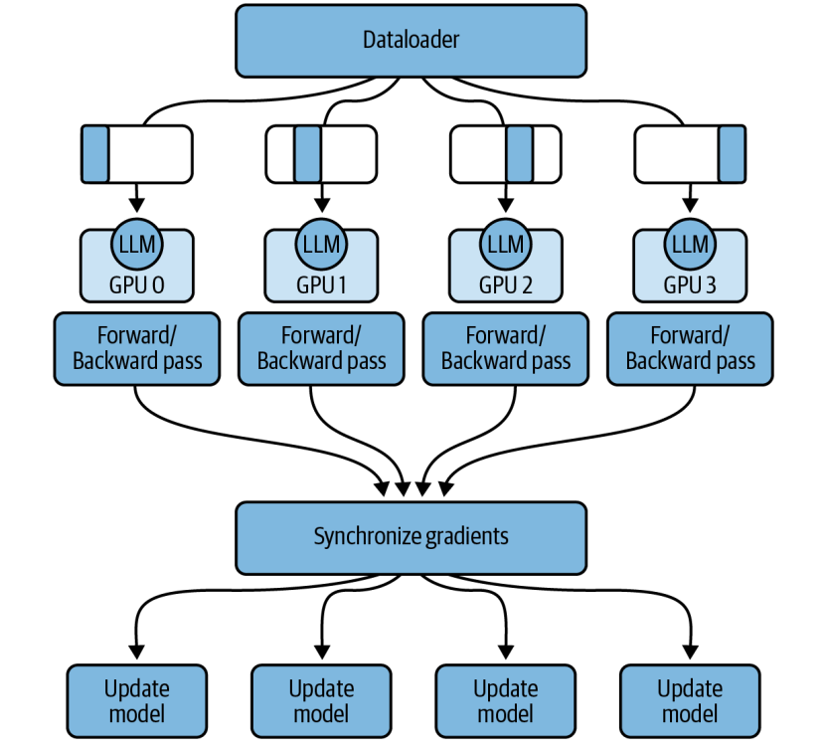

Slide 19
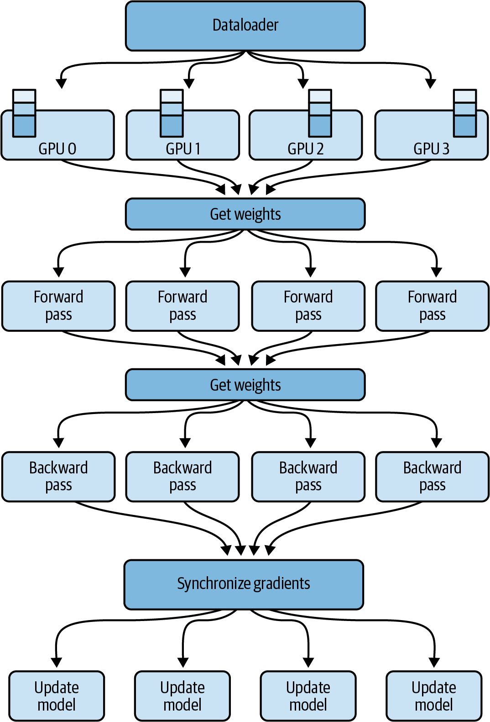
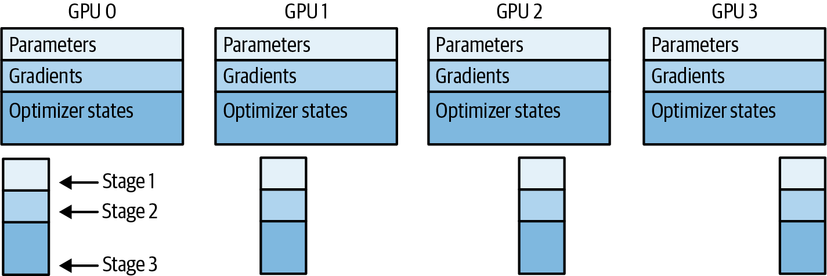

Slide 20
FSDP & the Three ZeRO Stages
ZeRO (Zero Redundancy Optimizer) progressively shards more of the training state across GPUs to cut memory.
Stage 1
Stage 2
Stage 3
Shards optimizer states
Shards optimizer states + gradients
Shards everything — incl. model parameters
up to 4×
up to 8×
up to n×
memory reduction
memory reduction
(n = number of GPUs)

Slide 21
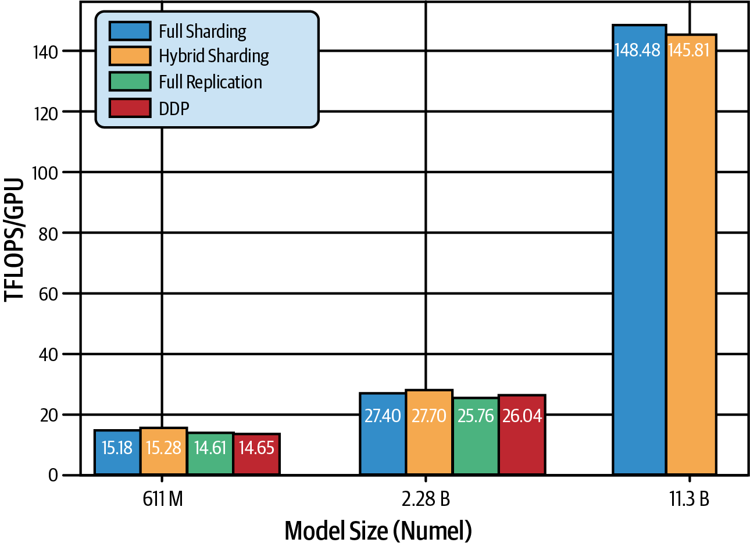
Reference from Pytorch FSDP Paper

Slide 22
Distributed Training on AWS
Amazon SageMaker runs scalable, cost-effective distributed training
Launch FSDP with the PyTorch Estimator — the sharding factor is just a config parameter
Train on AWS Trainium via the AWS Neuron SDK
Hugging Face Optimum Neuron bridges Transformers with the Neuron SDK
Trained on SageMaker
Falcon-180B
512 instances · 4,096 A100 GPUs
≈ 164 TB of GPU RAM
BloombergGPT
64 instances · 512 GPUs
≈ 20 TB of GPU RAM

Slide 23
AWS Services for Distributed Training
Amazon SageMaker
AWS Trainium
Managed training platform
Purpose-built ML accelerator
Spins up distributed clusters with a few lines of code; supports DDP and FSDP out of the box.
Custom silicon for high-performance, cost-efficient training of 100B+ parameter models.
▸ Trained Falcon-180B & BloombergGPT
▸ Up to 16 chips · 512 GB shared memory
AWS Neuron SDK
Optimum Neuron
Developer interface to Trainium
Hugging Face × Neuron bridge
Compiles and runs deep-learning workloads on Trainium hardware via PyTorch & TensorFlow.
Connects the Transformers ecosystem to the Neuron SDK with drop-in training classes.
▸ Optimized for quantization & sharding
▸ NeuronTrainer replaces Trainer

Slide 24
Implementing FSDP on SageMaker
How it works
PyTorch Estimator - FSDP launch
from sagemaker.pytorch import PyTorch
estimator = PyTorch(
entry_point="train.py",
instance_type="ml.p4d.24xlarge",
instance_count=2,
distribution={
"fsdp": {
"sharding_factor": 16
}},
)
estimator.fit()
2 instances × 8 GPUs = 320 GB of GPU RAM
The distribution config switches SageMaker to FSDP
sharding_factor = total GPUs (16) → full sharding
train.py holds the model + training loop (full code in the book's GitHub repo)
One config change scales DDP → FSDP

Slide 25
Training on AWS Trainium
Purpose-built for training
Optimum Neuron - drop-in NeuronTrainer
from optimum.neuron import (
NeuronTrainer,
NeuronTrainingArguments)
args = NeuronTrainingArguments(
per_device_train_batch_size=8,
bf16=True)
trainer = NeuronTrainer(
model=model,
args=args,
train_dataset=dataset)
trainer.train()
AWS Trainium chips are purpose-built for high-performance, low-cost training
The AWS Neuron SDK is the developer interface to Trainium hardware
Hugging Face Optimum Neuron bridges the Transformers ecosystem to the Neuron SDK
NeuronTrainer is a drop-in replacement for the Transformers Trainer
Same training code → new accelerator

Slide 26
Summary & What's Next
Training large models is constrained by GPU memory — a 1B-param model needs ~24 GB to train at FP32
Quantization lowers precision (BF16, FP8, INT8) to cut memory 50–75%
Attention optimizations (FlashAttention, GQA) speed up and shrink memory
DDP & FSDP scale training across many GPUs; AWS SageMaker + Trainium make it practical
Combine quantization + distributed computing to train very large models efficiently
Next — Chapter 5: Fine-tuning foundation models on your own datasets

